Slide 1

A Tutorial for Git and
GitHub

Slide 2

Agenda
Version (Source) Control Systems
What are Git and GitHub
Basic Git Commands
Fundamentals of GitHub
Using GitHub in Project Implementation

Slide 3
Version control systems
A version control system (often called a source code control system) does these things:
Keeps multiple (older and newer) versions of everything (not just source code)
Requests comments regarding every change
Allows “check in” and “check out” of files so you know which files someone else is working on
Displays differences between versions
7

Slide 4
Benefits of version control
For working by yourself:
Gives you a “time machine” for going back to earlier versions
Gives you great support for different versions (standalone, web app, etc.) of the same basic project
For working with others:
Greatly simplifies concurrent work, merging changes
8

Slide 5
What are Git and GitHub
Git is a free and open source distributed version control system designed to handle everything from small to very large projects with speed and efficiency
GitHub is a web-based Git repository hosting service, which offers all of the distributed revision control and source code management (SCM) functionality of Git as well as adding its own features.

Slide 6
How to setup Git and GitHub
Download and install the latest version of GitHub Desktop. This will automatically install Git and keep it up- to-date for you.
https://help.github.com/articles/set-up-git/

Slide 7
BASIC GIT COMMANDS

Slide 8
Introduce yourself to Git
On your computer, open the Git Shell application.
Enter these lines (with appropriate changes):
git config --global user.name "John Smith"
git config --global user.email jsmith@seas.upenn.edu
You only need to do this once
If you want to use a different name/email address for a particular project, you can change it for just that project
cd to the project directory
Use the above commands, but leave out the --global
12

Slide 9

The repository
Your top-level working directory contains everything about your project
The working directory probably contains many subdirectories—source code, binaries,
documentation, data files, etc.
One of these subdirectories, named .git, is your repository
At any time, you can take a “snapshot” of everything (or selected things) in
your project directory, and put it in your repository
This “snapshot” is called a commit object
The commit object contains (1) a set of files, (2) references to the “parents” of the commit object, and (3) a unique “SHA1” name
Commit objects do not require huge amounts of memory
You can work as much as you like in your working directory, but the repository isn’t updated until you commit something
13

Slide 10

init and the .git repository
When you said git init in your project directory, or when you cloned an existing project, you created a repository
The repository is a subdirectory named .git containing various files
The dot indicates a “hidden” directory
You do not work directly with the contents of that directory; various git commands do that for you
14

Slide 11

Making commits
You do your work in your project directory, as usual
If you create new files and/or folders, they are not tracked by Git unless you ask it to do so
git add newFile1 newFolder1 newFolder2 newFile2
Committing makes a “snapshot” of everything being tracked into your repository
A message telling what you have done is required
git commit –m “Uncrevulated the conundrum bar”
git commit
This version opens an editor for you the enter the message
To finish, save and quit the editor
Format of the commit message
One line containing the complete summary
If more than one line, the second line must be blank
15

Slide 12

Commits and graphs
A commit is when you tell git that a change (or addition) you have made is ready to be included in the project
When you commit your change to git, it creates a commit object
A commit object represents the complete state of the project, including all the files in
the project
The very first commit object has no “parents”
Usually, you take some commit object, make some changes, and create a new commit
object; the original commit object is the parent of the new commit object
Hence, most commit objects have a single parent
You can also merge two commit objects to form a new one
The new commit object has two parents
Hence, commit objects forms a directed graph
Git is all about using and manipulating this graph
16

Slide 13
Commit messages
In git, “Commits are cheap.” Do them often.
When you commit, you must provide a one-line message stating what you have done
Terrible message: “Fixed a bunch of things”
Better message: “Corrected the calculation of median scores”
Commit messages can be very helpful, to yourself as well as to your team members
You can’t say much in one line, so commit often
17

Slide 14
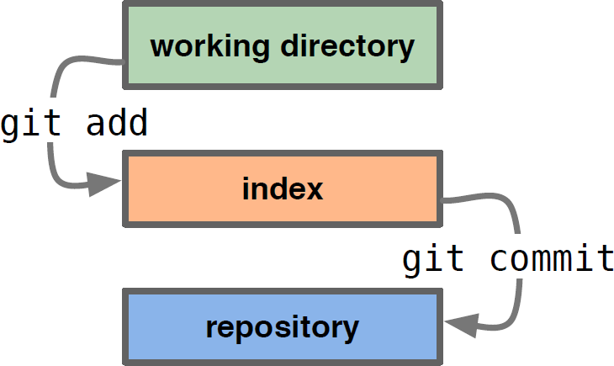
Typical workflow
git status
See what Git thinks is going on
Use this frequently!
Work on your files
git add your editfiles
git commit –m “What I did”
18

Slide 15
Keeping it simple
If you:
Make sure you are current with the central repository
Make some improvements to your code
Update the central repository before anyone else does
Then you don’t have to worry about resolving conflicts or working with multiple branches
All the complexity in git comes from dealing with these
Therefore:
Make sure you are up-to-date before starting to work
Commit and update the central repository frequently
If you need help: https://help.github.com/
19

Slide 16
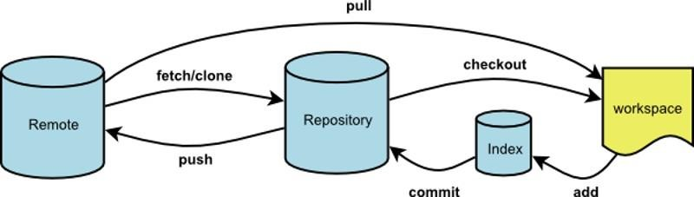
More Commands: Don’t Get Scared.
GitHub Desktop can Help You

Slide 17
FUNDAMENTALS OF GITHUB

Slide 18
Introduce yourself to GitHub
Register on GitHub
https://github.com/
Authenticating to GitHub Desktop
https://help.github.com/desktop/guides/getting- started/authenticating-to-github/
Configuring Git for GitHub Desktop
https://help.github.com/desktop/guides/getting- started/configuring-git-for-github-desktop/

Slide 19
Create or add a repository to GitHub
Create a new repository on GitHub
https://help.github.com/articles/create-a-repo/
From GitHub Desktop, then Publish to GitHub
https://help.github.com/desktop/guides/contributing/adding-a- repository-from-your-local-computer-to-github-desktop/
Remember to Publish, otherwise your repository would not appear on the GitHub website.

Slide 20
Commit your changes on GitHub
From GitHub Website
https://help.github.com/articles/create-a-repo/
From GitHub Desktop
https://help.github.com/desktop/guides/contributing/committing- and-reviewing-changes-to-your-project/

Slide 21
Creating a branch for your work
A branch is a parallel version of the main line of development in the repository, or the default branch (usually master). Use branches to
Develop features
Fix bugs
Safely experiment with new ideas
From the GitHub Website
https://help.github.com/articles/creating-and-deleting-branches-within-your-repository/
From the GitHub Desktop
https://help.github.com/desktop/guides/contributing/creating-a-branch-for-your-work/

Slide 22

Synchronizing your branch
As commits are pushed to your project on GitHub, you can keep your local copy of the project in sync with the remote repository.
https://help.github.com/desktop/guides/contributing/syncing- your-branch/

Slide 23
Viewing the history of your commits
When you click a commit on the commit timeline, you can see more details about the commit, including a diff of the changes the commit introduced.
Each commit shows:
The commit message
The time the commit was created
The committer's username and profile photo (if available)
The commit's SHA-1 hash (the unique ID)

Slide 24
Revert your commit
If you change your mind about a commit after you create it, you can revert the commit.
When you revert to a previous commit, the revert is also a commit. In addition, the original commit remains in the repository's history.
https://help.github.com/desktop/guides/contributing/reverti ng-a-commit/

Slide 25
Fork & Pull: A Collaborative model
A fork is a copy of a repository that you manage. Forks let you make changes to a project without affecting the original repository. You can fetch updates from or submit changes to the original repository with pull requests.
A great example of using forks to propose changes is for bug fixes. Rather than logging an issue for a bug you've found, you can:
Fork the repository.
Make the fix.
Submit a pull request to the project owner.

Slide 26
Using GitHub in Project Implementation
In the section of project implementation in your project report, you may describe:
How you use GitHub in your project
How version control helps your quality management
How you collaborate with your teammate in GitHub

Slide 27
References
Some content of the slides are adapted from:
https://help.github.com/desktop/guides/getting-started/
https://help.github.com/desktop/guides/contributing/
https://help.github.com/categories/collaborating/
http://www.cis.upenn.edu/~matuszek/cit591- 2012/Lectures/git.ppt

